Slide 1
Webinar: From Hadoop to Spark
Introduction
Hadoop and Spark Comparison
From Hadoop to Spark
Notes:
Session 2: Introduction to Spark

Slide 2
Webinar Objectives
Intro: what is Hadoop and what is Spark?
Spark's capabilities and advantages vs Hadoop
From Hadoop to Spark – how to?
Notes:
Session 2: Introduction to Spark

Slide 3
Introduction
Introduction
Hadoop and Spark Comparison
From Hadoop to Spark
Notes:
Session 2: Introduction to Spark

Slide 4
Hadoop in 20 Seconds
‘The’ Big data platform
Very well field tested
Scales to peta-bytes of data
MapReduce : Batch oriented compute

Slide 5
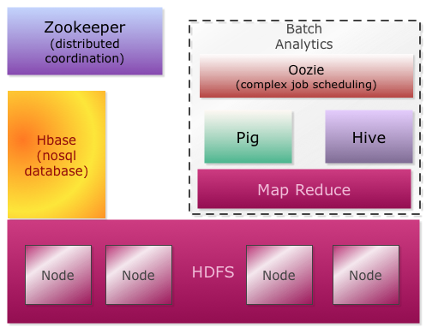
Hadoop Eco System
Real Time
Batch

Slide 6
Hadoop Ecosystem – by function
HDFS
provides distributed storage
Map Reduce
Provides distributed computing
Pig
High level MapReduce
Hive
SQL layer over Hadoop
HBase
NoSQL storage for real-time queries

Slide 7
Spark in 20 Seconds
Fast & Expressive Cluster computing engine
Compatible with Hadoop
Came out of Berkeley AMP Lab
Now Apache project
Version 1.3 just released (April 2015)
“First Big Data platform to integrate batch, streaming and interactive computations in a unified framework” – stratio.com

Slide 8
Spark Eco-System
Schema / sql
Real Time
Machine Learning
Graph processing
Spark
SQL
Spark
Streaming
ML lib
GraphX
Spark Core
Cluster
managers
Stand alone
YARN
MESOS

Slide 9

Hypo-meter ☺

Slide 10
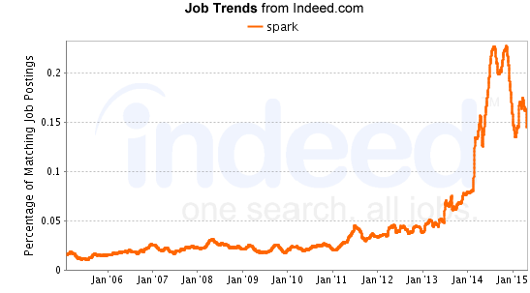
Spark Job Trends

Slide 11
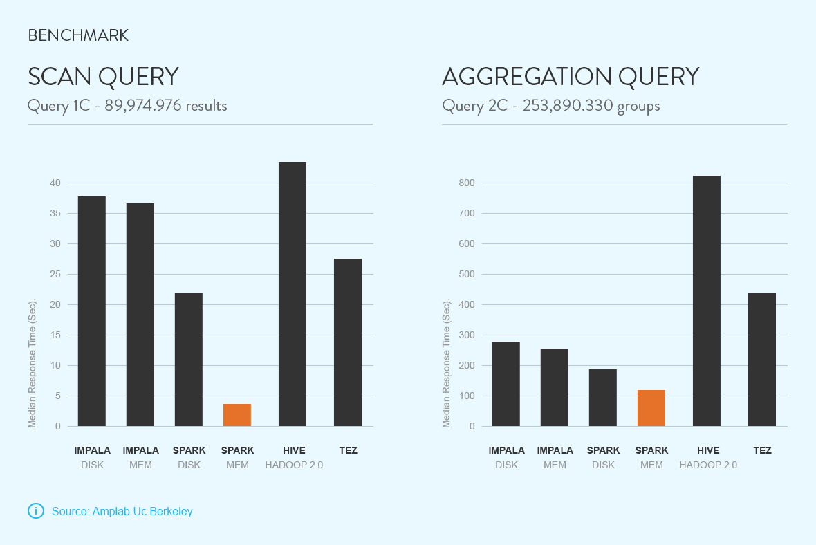
Spark Benchmarks
Source : stratio.com

Slide 12
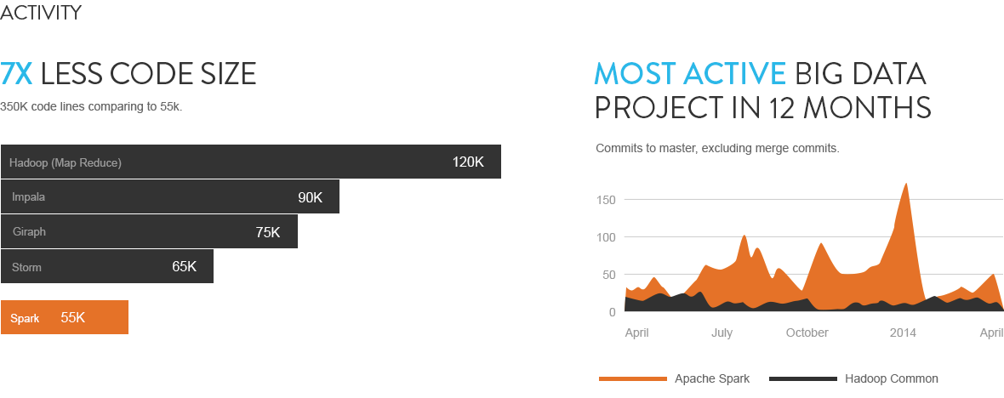
Spark Code / Activity
Source : stratio.com

Slide 13
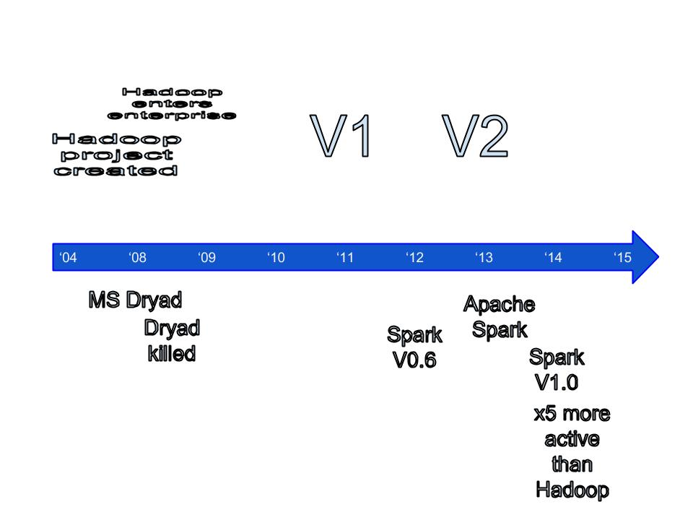
Timeline : Hadoop & Spark

Slide 14
Hadoop and Spark Comparison
Introduction
Hadoop and Spark Comparison
Going from Hadoop to Spark
Session 2: Introduction to Spark
Notes:
Session 2: Introduction to Spark

Slide 15

Hadoop Vs. Spark
Spark
Hadoop
Source : http://www.kwigger.com/mit-skifte-til-mac/

Slide 16
Comparison With Hadoop
Hadoop | Spark
Distributed Storage + Distributed Compute | Distributed Compute Only
MapReduce framework | Generalized computation
Usually data on disk (HDFS) | On disk / in memory
Not ideal for iterative work | Great at Iterative workloads (machine learning ..etc)
Batch process | - Up 10x faster for data on disk - Up to 100x faster for data in memory
 | Compact code Java, Python, Scala supported
 | Shell for ad-hoc exploration

Slide 17
Hadoop + Yarn : OS for Distributed Compute
Batch
(mapreduce)
Streaming
(storm, S4)
In-memory
(spark)
Applications
YARN
Cluster
Management
HDFS
Storage
(or at least, that’s the idea)
Notes:
Hadoop is evolving into a platform for other distributed applications

Slide 18
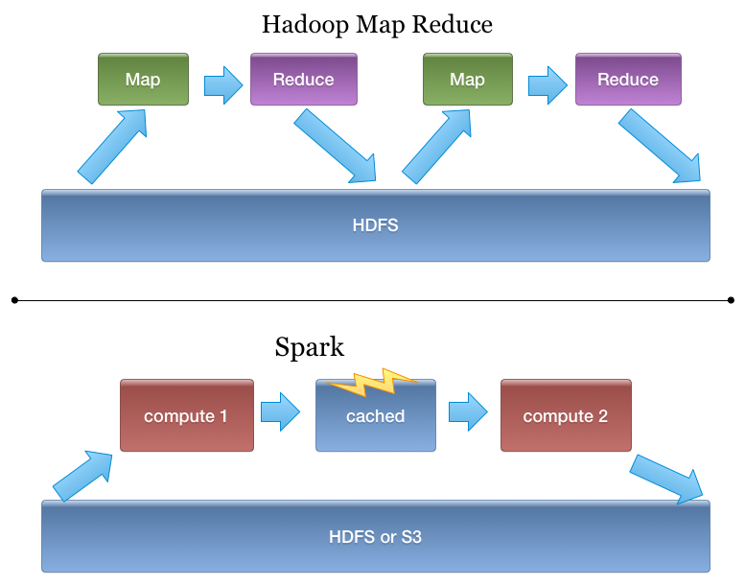
Spark Is Better Fit for Iterative Workloads
Notes:
In Hadoop data has to be persisted in HDFS between jobs
In Spark, it can be kept in memory

Slide 19
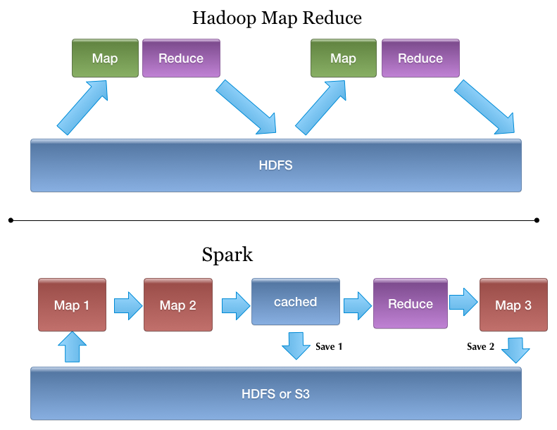
Spark Programming Model
More generic than MapReduce

Slide 20
Is Spark Replacing Hadoop?
Spark runs on Hadoop / YARN
Complimentary
Spark programming model is more flexible than MapReduce
Spark is really great if data fits in memory (few hundred gigs),
Spark is ‘storage agnostic’ (see next slide)

Slide 21
Spark & Pluggable Storage
Spark
(compute engine)
HDFS
Amazon S3
Cassandra
???
Notes:
Spark can work with lots of storage types

Slide 22
Spark & Hadoop
Use Case | Other | Spark
Batch processing | Hadoop’s MapReduce (Java, Pig, Hive) | Spark RDDs (java / scala / python)
SQL querying | Hadoop : Hive | Spark SQL
Stream Processing / Real Time processing | Storm Kafka | Spark Streaming
Machine Learning | Mahout | Spark ML Lib
Real time lookups | NoSQL (Hbase, Cassandra ..etc) | No Spark component. But Spark can query data in NoSQL stores

Slide 23


Hadoop & Spark Future ???

Slide 24
Going from Hadoop to Spark
Introduction
Hadoop and Spark Comparison
Going from Hadoop to Spark
Session 2: Introduction to Spark
Notes:
Session 2: Introduction to Spark

Slide 25
Why Move From Hadoop to Spark?
Spark is ‘easier’ than Hadoop
‘friendlier’ for data scientists / analysts
Interactive shell
fast development cycles
adhoc exploration
API supports multiple languages
Java, Scala, Python
Great for small (Gigs) to medium (100s of Gigs) data
Notes:
You can use python libraries for Machine learning ..etc

Slide 26

Spark : ‘Unified’ Stack
Spark supports multiple programming models
Map reduce style batch processing
Streaming / real time processing
Querying via SQL
Machine learning
All modules are tightly integrated
Facilitates rich applications
Spark can be the only stack you need !
No need to run multiple clusters (Hadoop cluster, Storm cluster, … etc.)
Image: buymeposters.com

Slide 27
Migrating From Hadoop → Spark
Functionality | Hadoop | Spark
Distributed Storage | HDFS | Cloud storage like Amazon S3 Or NFS mounts
SQL querying | Hive | Spark SQL
ETL work flow | Pig | Spork : Pig on Spark Mix of Spark SQL
Machine Learning | Mahout | ML Lib
NoSQL DB | HBase | ???
Notes:
It is possible to go from Hadoop to Spark
Consider the alternatives

Slide 28
Five Steps of Moving From Hadoop to Spark
Data size
File System
SQL
ETL
Machine Learning

Slide 29
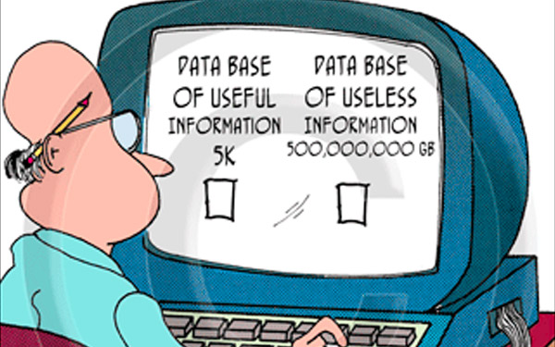
Data Size : “You Don’t Have Big Data”

Slide 30
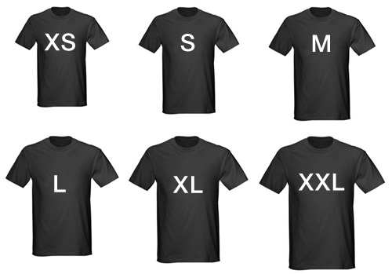
1) Data Size (T-shirt sizing)
Spark
< few G
10 G +
100 G +
1 TB +
100 TB +
PB +
Hadoop
Image credit : blog.trumpi.co.za

Slide 31
1) Data Size
Lot of Spark adoption at SMALL – MEDIUM scale
Good fit
Data might fit in memory !!
Hadoop may be overkill
Applications
Iterative workloads (Machine learning, etc.)
Streaming
Hadoop is still preferred platform for TB + data

Slide 32
2) File System
Hadoop = Storage + Compute Spark = Compute only Spark needs a distributed FS
File system choices for Spark
HDFS - Hadoop File System
Reliable
Good performance (data locality)
Field tested for PB of data
S3 : Amazon
Reliable cloud storage
Huge scale
NFS : Network File System (‘shared FS across machines)

Slide 33
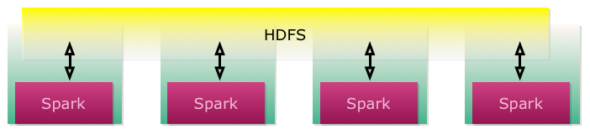
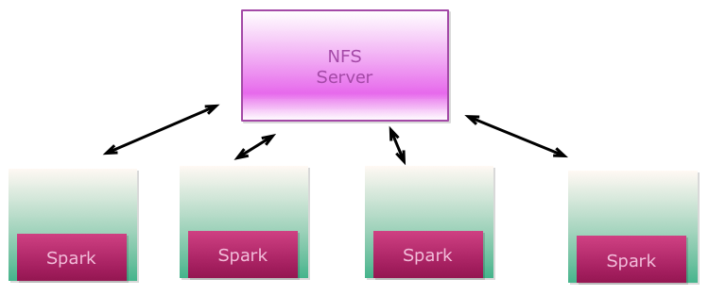
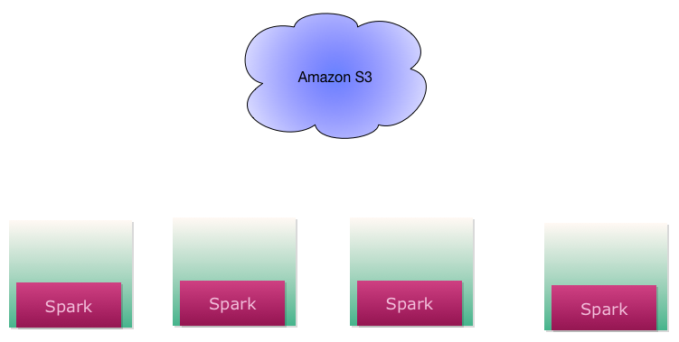
Spark File Systems

Slide 34
File Systems For Spark
 | HDFS | NFS | Amazon S3
Data locality | High (best) | Local enough | None (ok)
Throughput | High (best) | Medium (good) | Low (ok)
Latency | Low (best) | Low | High
Reliability | Very High (replicated) | Low | Very High
Cost | Varies | Varies | $30 / TB / Month

Slide 35
File Systems Throughput Comparison
Data : 10G + (11.3 G)
Each file : ~1+ G ( x 10)
400 million records total
Partition size : 128 M
On HDFS & S3
Cluster :
8 Nodes on Amazon m3.xlarge (4 cpu , 15 G Mem, 40G SSD )
Hadoop cluster , Latest Horton Works HDP v2.2
Spark : on same 8 nodes, stand-alone, v 1.2

Slide 36
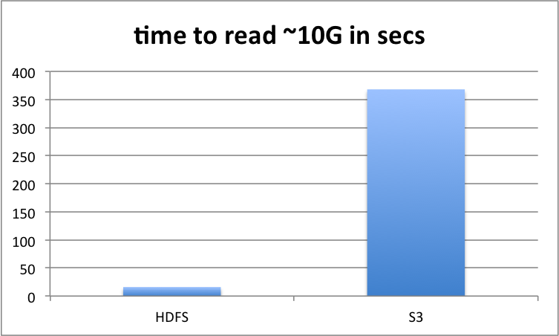
HDFS Vs. S3 (lower is better)

Slide 37
HDFS Vs. S3 Conclusions
HDFS | S3
Data locality → much higher throughput | Data is streamed → lower throughput
Need to maintain an Hadoop cluster | No Hadoop cluster to maintain → convenient
Large data sets (TB + ) | Good use case: Smallish data sets (few gigs) Load once and cache and re-use

Slide 38
3) SQL in Hadoop / Spark
 | Hadoop | Spark
Engine | Hive | Spark SQL
Language | HiveQL | - HiveQL - RDD programming in Java / Python / Scala
Scale | Petabytes | Terabytes ?
Inter operability |  | Can read Hive tables or stand alone data
Formats | CSV, JSON, Parquet | CSV, JSON, Parquet

Slide 39
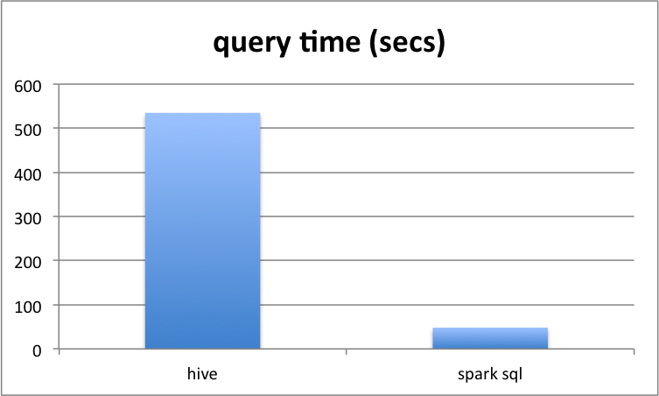
Spark SQL Vs. Hive
Fast on same HDFS data !

Slide 40
4) ETL on Hadoop / Spark
 | Hadoop | Spark
ETL Tools | Pig, Cascading, Oozie | Native RDD programming (Scala, Java, Python)
Pig | High level ETL workflow | Spork : Pig on Spark
Cascading | High level | Spark-scalding

Slide 41
4) ETL On Hadoop / Spark : Conclusions
Try spork or spark-scalding
Code re-use
Not re-writing from scratch
Program RDDs directly
More flexible
Multiple language support : Scala / Java / Python
Simpler / faster in some cases
Our experience of porting a financial application
Tresata vs. RDD

Slide 42
5) Machine Learning : Hadoop / Spark
 | Hadoop | Spark
Tool | Mahout | MLLib
API | Java | Java / Scala / Python
Iterative Algorithms | Slower | Very fast (in memory)
In Memory processing | No | YES
 | Mahout runs on Hadoop or on Spark | New and young lib
Latest news! | Mahout only accepts new code that runs on Spark | Mahout & MLLib on Spark Future? Many opinions
Notes:
TODO : our experience
Ted Dunning: Mahout is true and verified, and focussed, MLLib is more of a loose collection
Frank Dai (Spark contributor): Mahout will concentrate on machine learning and have a rich set of algorithms, while MLLib will adopt only most essential and mature algorithms

Slide 43
Our experience, legal (eDiscovery)
FreeEed (Hadoop) | 3VEed (Storm, Spark)
Scalable document processing
All Enron docs in 1 hour (50-node Hadoop)
 | Allows dynamically adding data sources Use case: more data discovered for the same lawsuit
 | Allows real-time data processing User case: real-time emails
 | Provide much improved load balancing Example: 10 GB PST mailbox
 | Overall: a much better fit for modern data governance

Slide 44
Final Thoughts
Already on Hadoop?
Try Spark side-by-side
Process some data in HDFS
Try Spark SQL for Hive tables
Contemplating Hadoop?
Try Spark (standalone)
Choose NFS or S3 file system
Take advantage of caching
Iterative loads
Spark Job servers
Tachyon
Build new class of ‘big / medium data’ apps

Slide 45
Thanks !
http://elephantscale.com
Expert consulting & training in Big Data
(Now offering Spark training)

Slide 46
Spark Caching!
Reading data from remote FS (S3) can be slow
For small / medium data ( 10 – 100s of GB) use caching
Pay read penalty once
Cache
Then very high speed computes (in memory)
Recommended for iterative work-loads

Slide 47
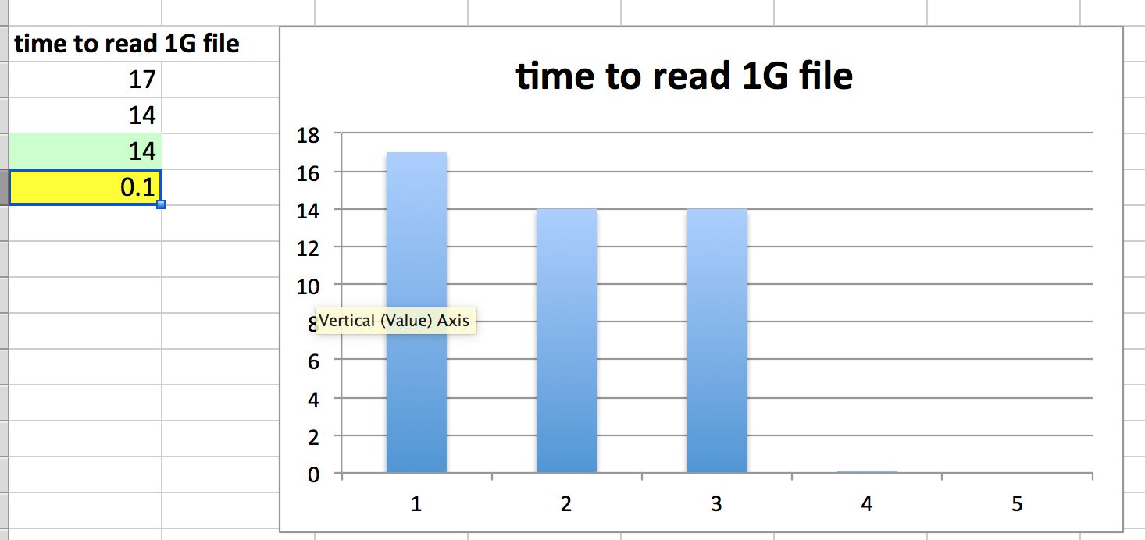
Caching Results
Cached!

Slide 48
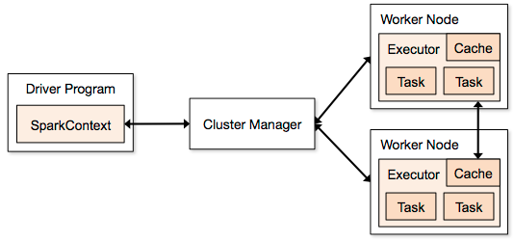
Spark Caching
Caching is pretty effective (small / medium data sets)
Cached data can not be shared across applications (each application executes in its own sandbox)

Slide 49
Sharing Cached Data
1) ‘spark job server’
Multiplexer
All requests are executed through same ‘context’
Provides web-service interface
2) Tachyon
Distributed In-memory file system
Memory is the new disk!
Out of AMP lab , Berkeley
Early stages (very promising)

Slide 50
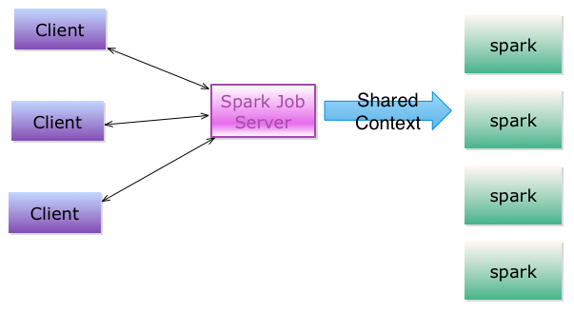
Spark Job Server

Slide 51
Spark Job Server
Open sourced from Ooyala
‘Spark as a Service’ – simple REST interface to launch jobs
Sub-second latency !
Pre-load jars for even faster spinup
Share cached RDDs across requests (NamedRDD)
App1 : ctx.saveRDD(“my cached rdd”, rdd1)
App2: RDD rdd2 = ctx.loadRDD (“my cached rdd”)
https://github.com/spark-jobserver/spark-jobserver

Slide 52
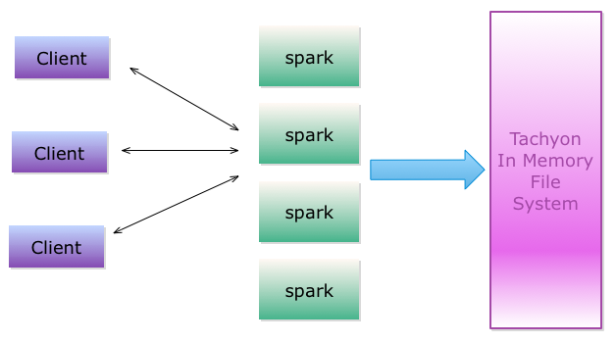
Tachyon + Spark

Slide 53
Next : New Big Data Applications With Spark

Slide 54
Big Data Applications : Now
Analysis is done in batch mode (minutes / hours)
Final results are stored in a real time data store like Cassandra / Hbase
These results are displayed in a dashboard / web UI
Doing interactive analysis ????
Need special BI tools

Slide 55
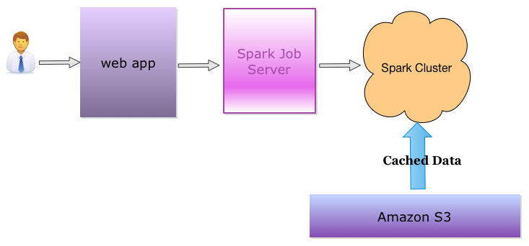
With Spark…
Load data set (Giga bytes) from S3 and cache it (one time)
Super fast (sub-seconds) queries to data
Response time : seconds (just like a web app !)

Slide 56
Lessons Learned
Build sophisticated apps !
Web-response-time (few seconds) !!
In-depth analytics
Leverage existing libraries in Java / Scala / Python
‘data analytics as a service’

Slide 57

www.synerzip.com
Ashish Shanker
Ashish.Shanker@synerzip.com
469.374.0500
57

Slide 58
Synerzip in a Nutshell
Software product development partner for small/mid-sized technology companies
Exclusive focus on small/mid-sized technology companies, typically venture-backed companies in growth phase
By definition, all Synerzip work is the IP of its respective clients
Deep experience in full SDLC – design, dev, QA/testing, deployment
Dedicated team of high caliber software professionals for each client
Seamlessly extends client’s local team offering full transparency
Stable teams with very low turn-over
NOT just “staff augmentation, but provide full management support
Actually reduces risk of development/delivery
Experienced team – uses appropriate level of engineering discipline
Practices Agile development – responsive yet disciplined
Reduces cost – dual-site team, 50% cost advantage
Offers long-term flexibility – allows (facilitates) taking offshore team captive – aka “BOT” option

Slide 59











































































Synerzip Clients
Notes:
59
59

Slide 60

Join Us In Person
Agile Texas 2015 Tour
Presented by
Hemant Elhence & Vinayak Joglekar

Slide 61

Next Webinar
7 Sins of Scrum and other Agile Anti-Patterns
Complimentary Webinar: Tuesday, September 22, 2015 @ Noon CST
Presented by: Todd Little
IHM

Slide 62



Connect with Synerzip
@Synerzip_Agile
linkedin.com/company/synerzip
facebook.com/Synerzip
Ashish Shanker
Ashish.shanker@synerzip.com
469.374.0500
Notes:
62
62

